Slide 1
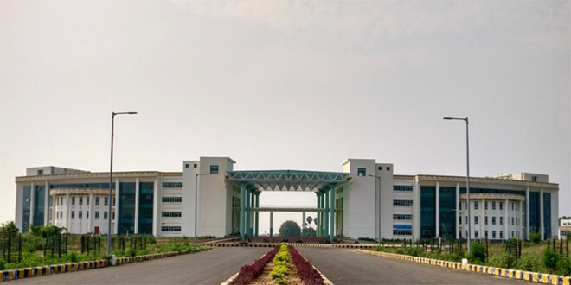

ns-3
Dr. Rajiv Misra
Associate Professor
Dept. of Computer Science & Engg.
Indian Institute of Technology Patna
rajivm@iitp.ac.in
ns-3

Slide 2
Getting Started With NS-3
☺ ☺ ☺
Install NS-3
Build NS-3

Slide 3
Building command
./waf –run scratch/file_name
(copied file inside the scratch folder)
For Animation
Generate the xml file then run from netanim folder
./NetAnim

Slide 4
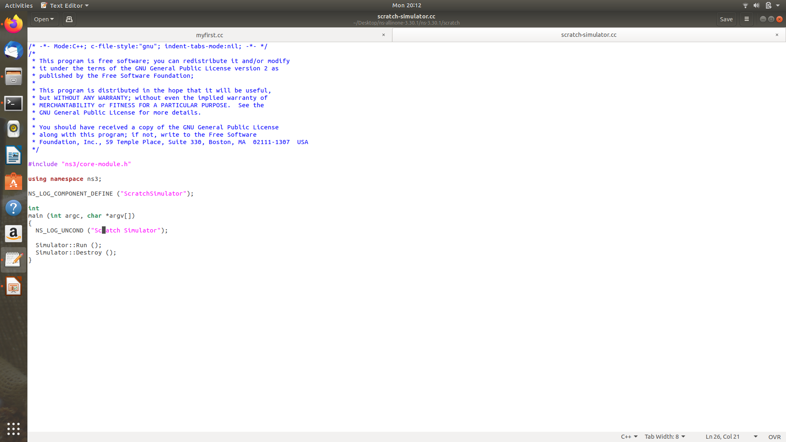
Basic NS-3 file

Slide 5
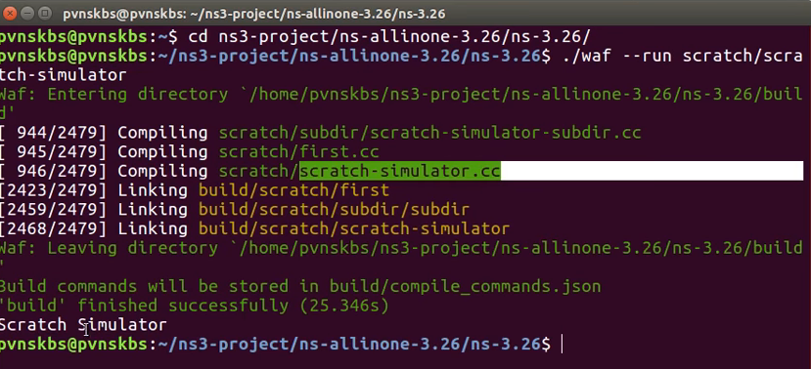
scratch-simulator.cc

Slide 6
First.cc
Simple network created between two nodes. Point-to-point network setup.

Slide 7
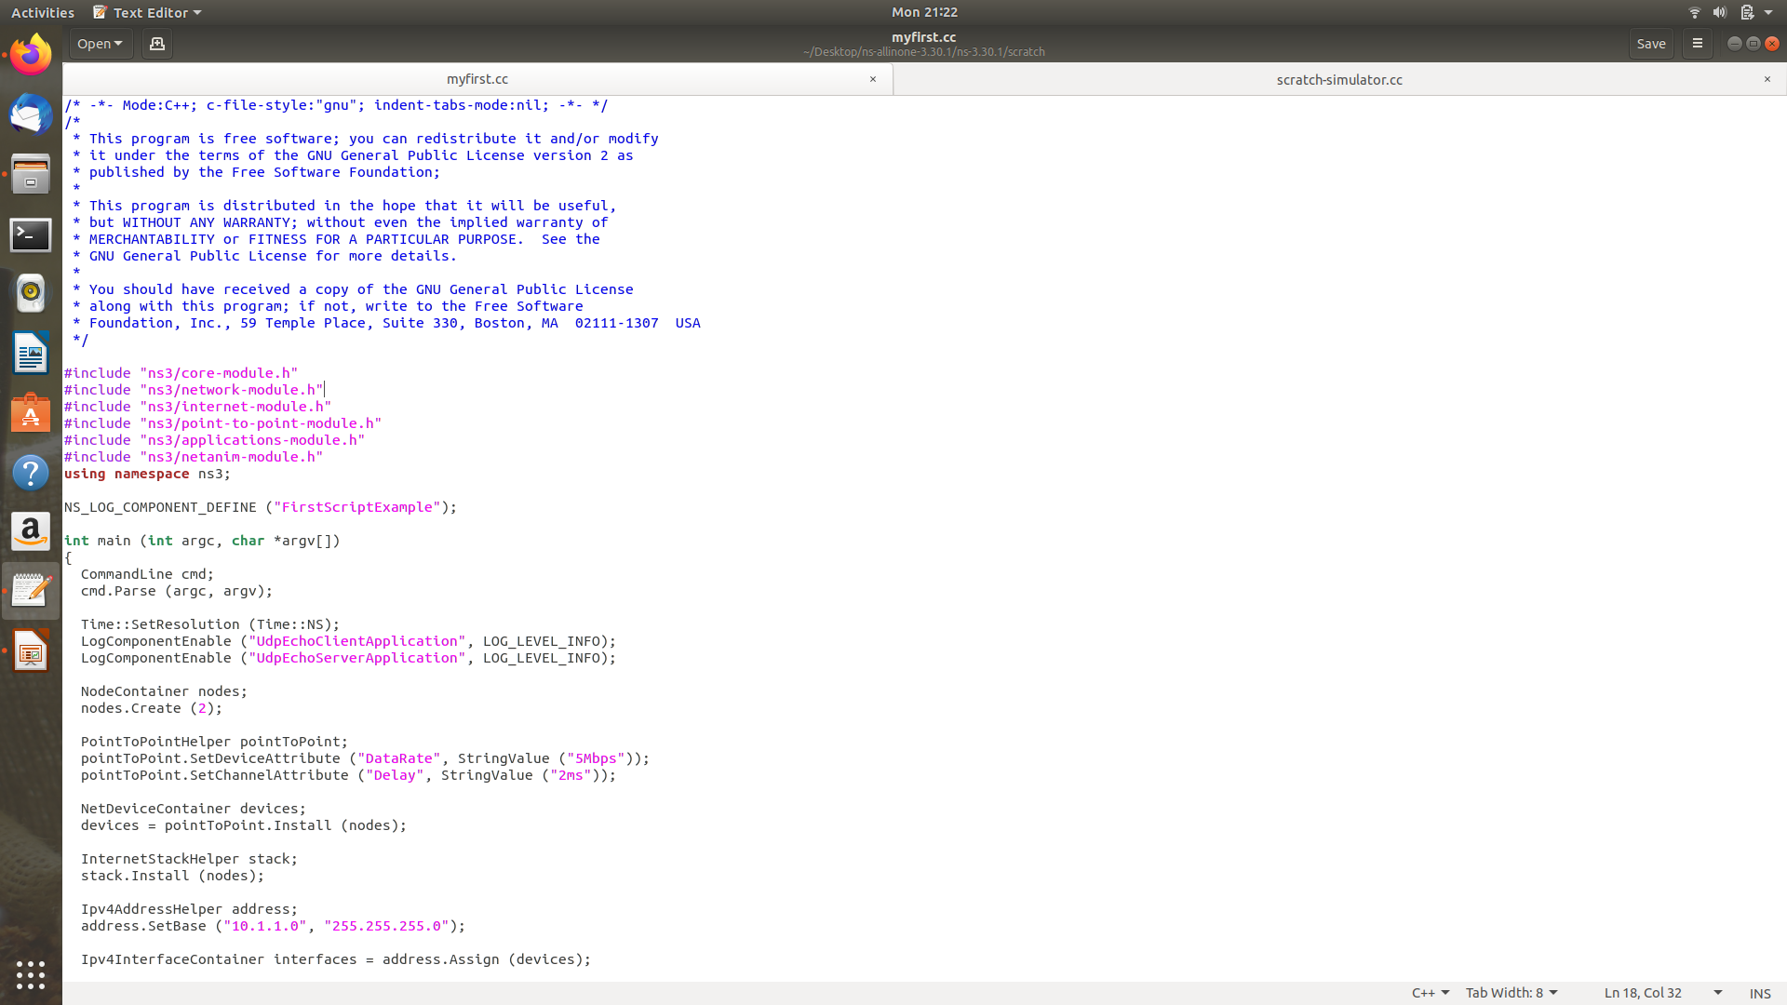
First.cc

Slide 8
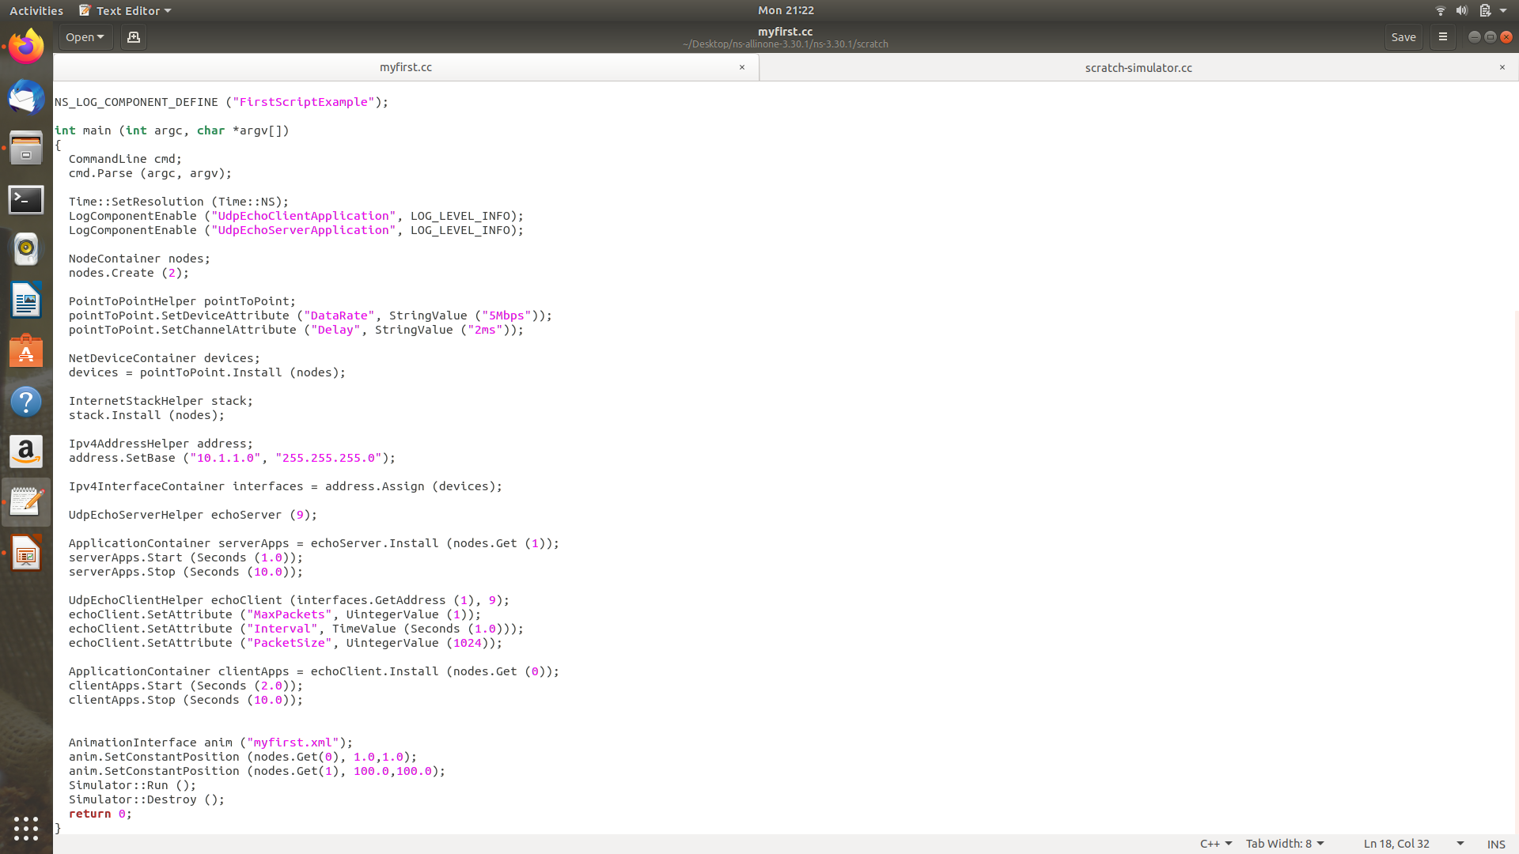
First.cc

Slide 9
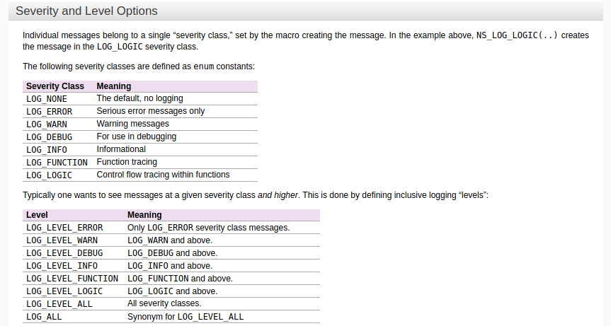
Logging Statements

Slide 10
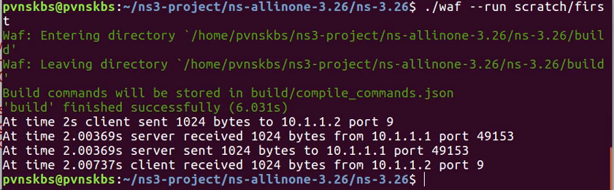
Output

Slide 11
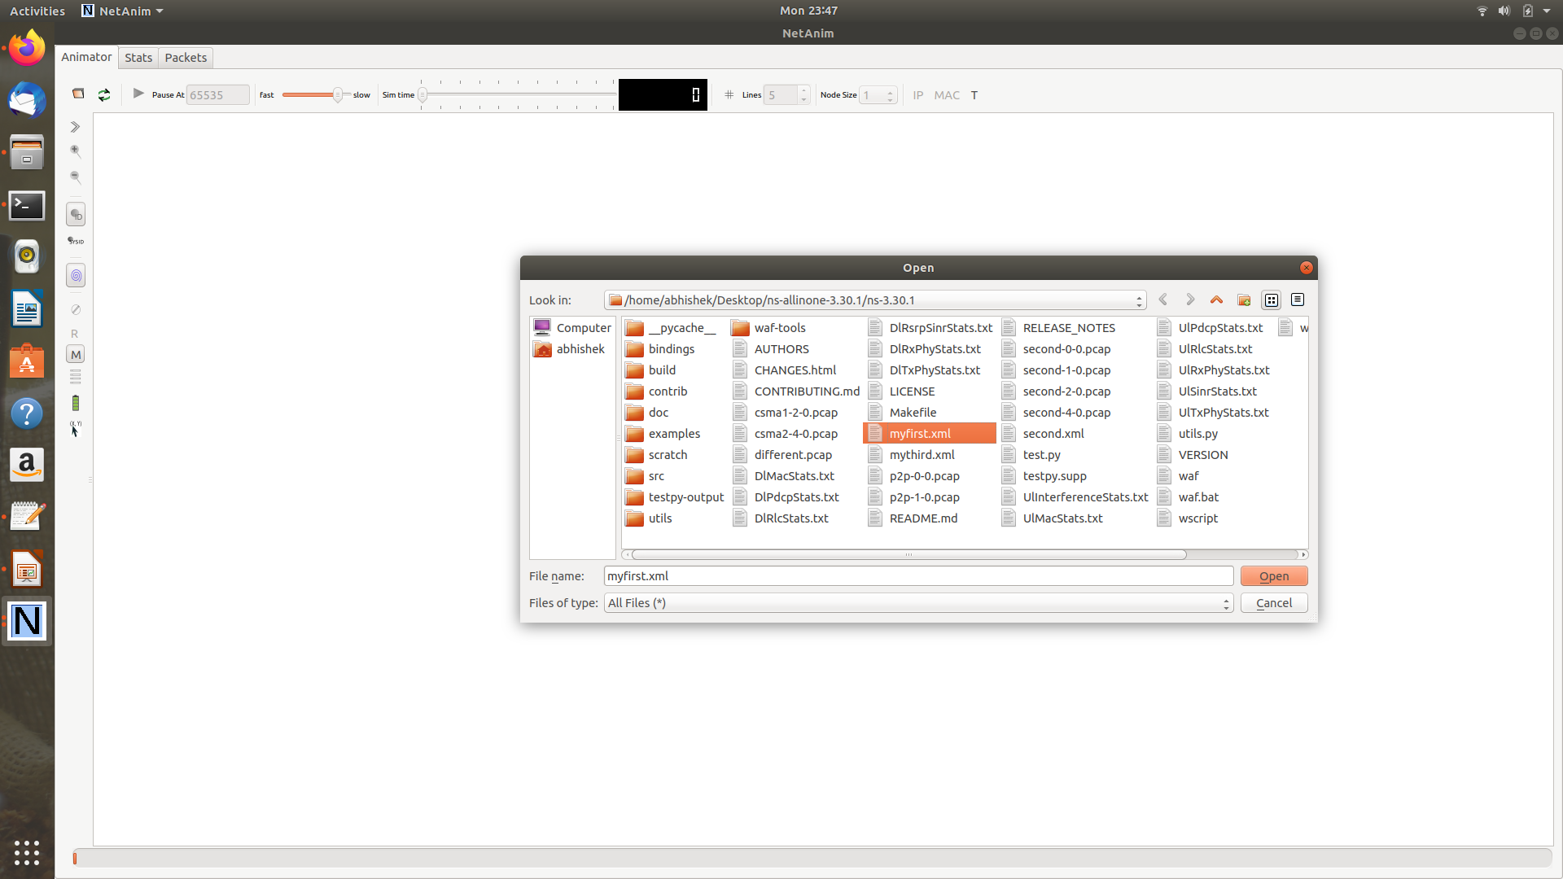
Loading the xml file

Slide 12
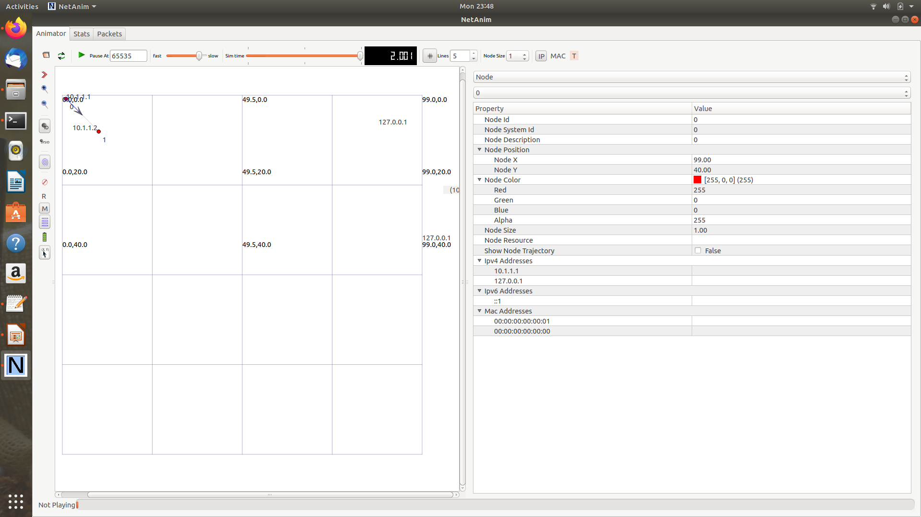
NetAnim first.cc

Slide 13
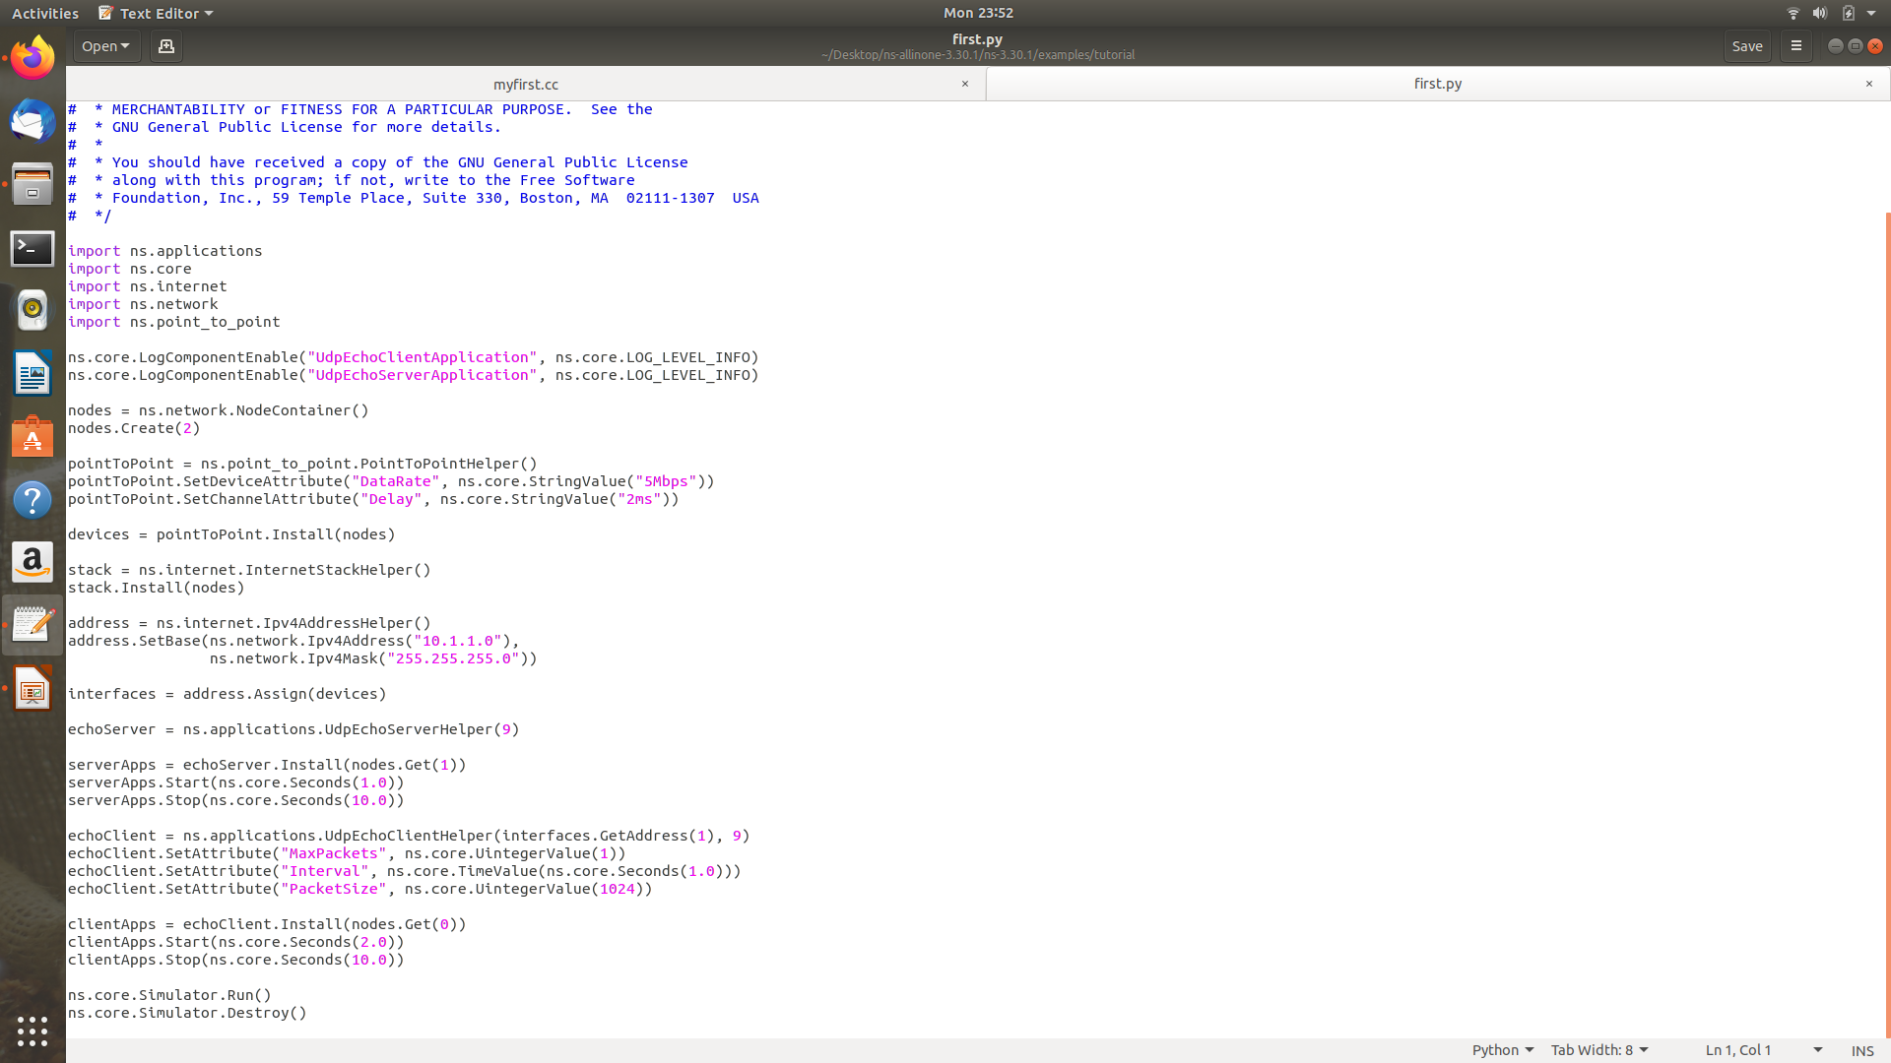
first.py

Slide 14
Second.cc
Two connection has been established, one is Point-To-Point while the other is CSMA.

Slide 15
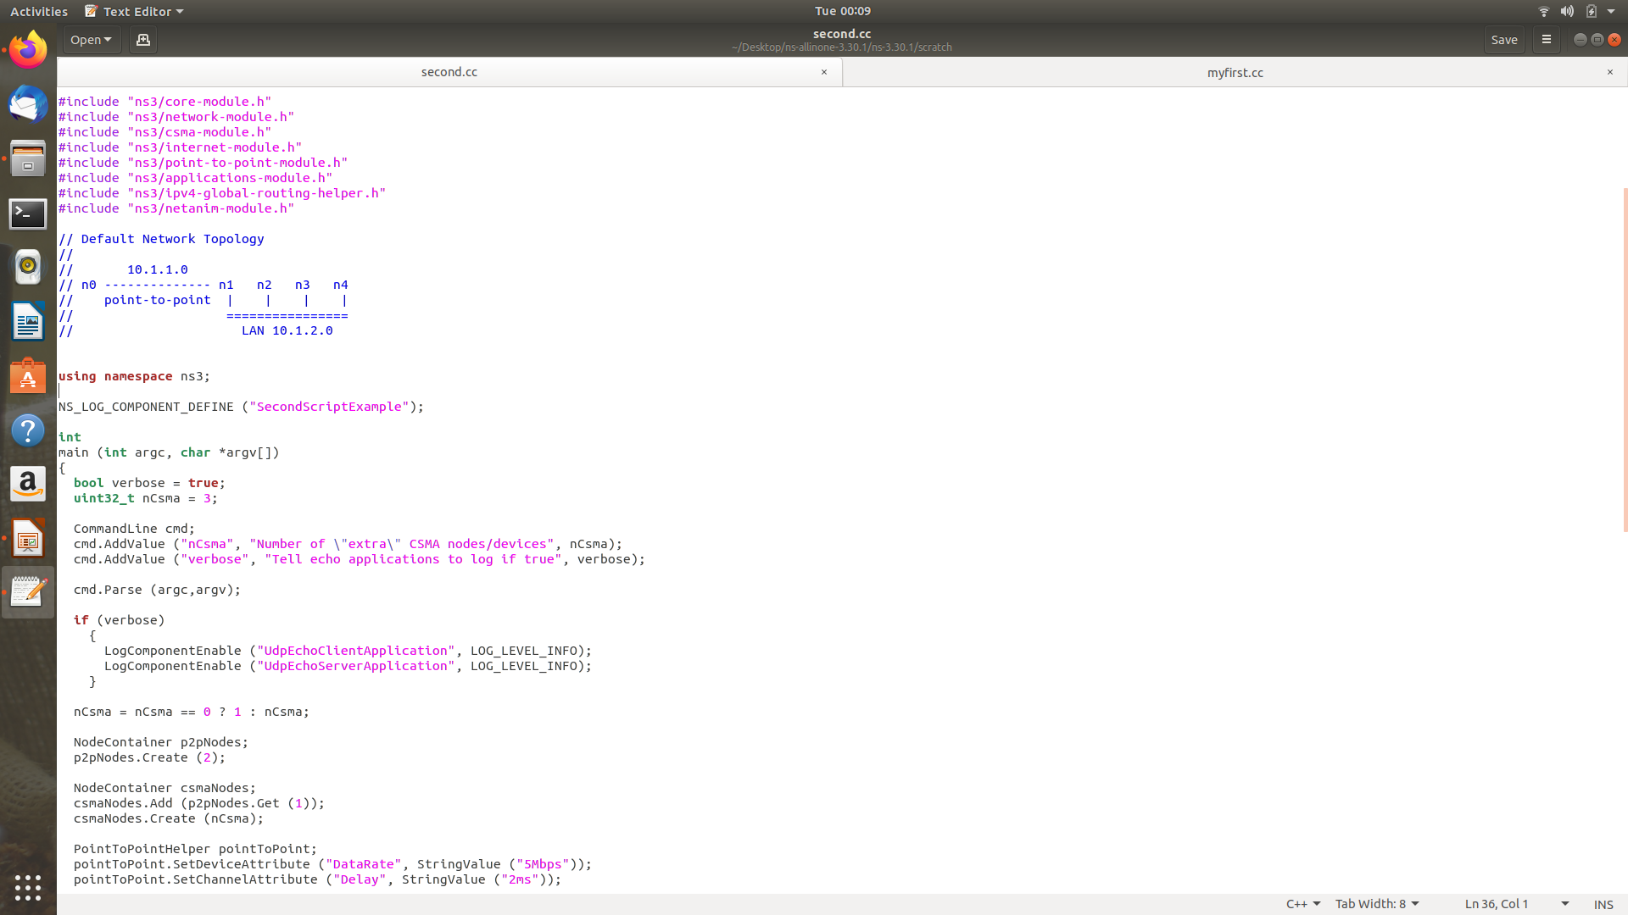
Second.cc

Slide 16
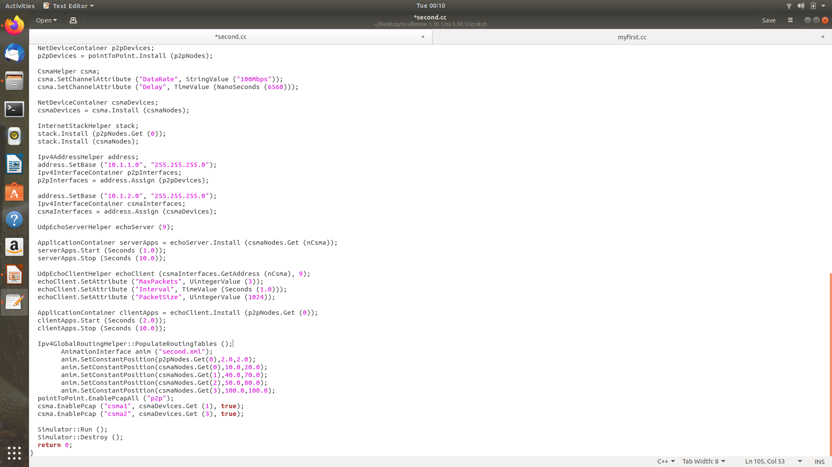
Second.cc

Slide 17
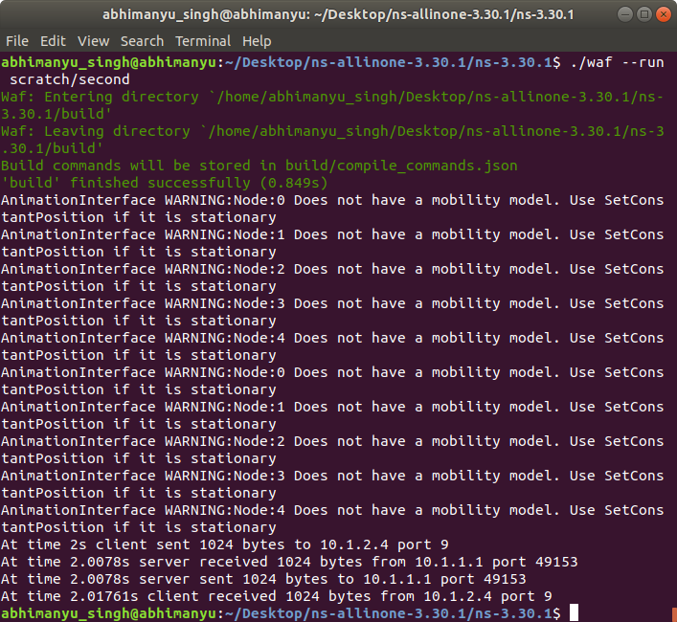
OUTPUT of second.cc

Slide 18
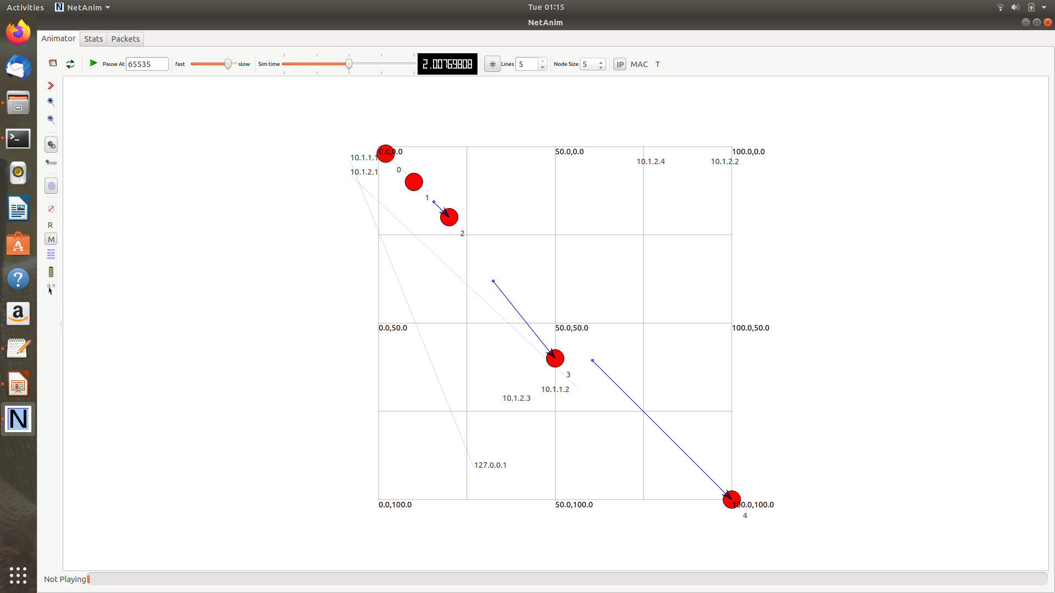
NetAnim ouput of second.cc

Slide 19
Third.cc
Wifi and Csma (i.e. LAN are connected)
One common connection in between is Point-To-Point

Slide 20
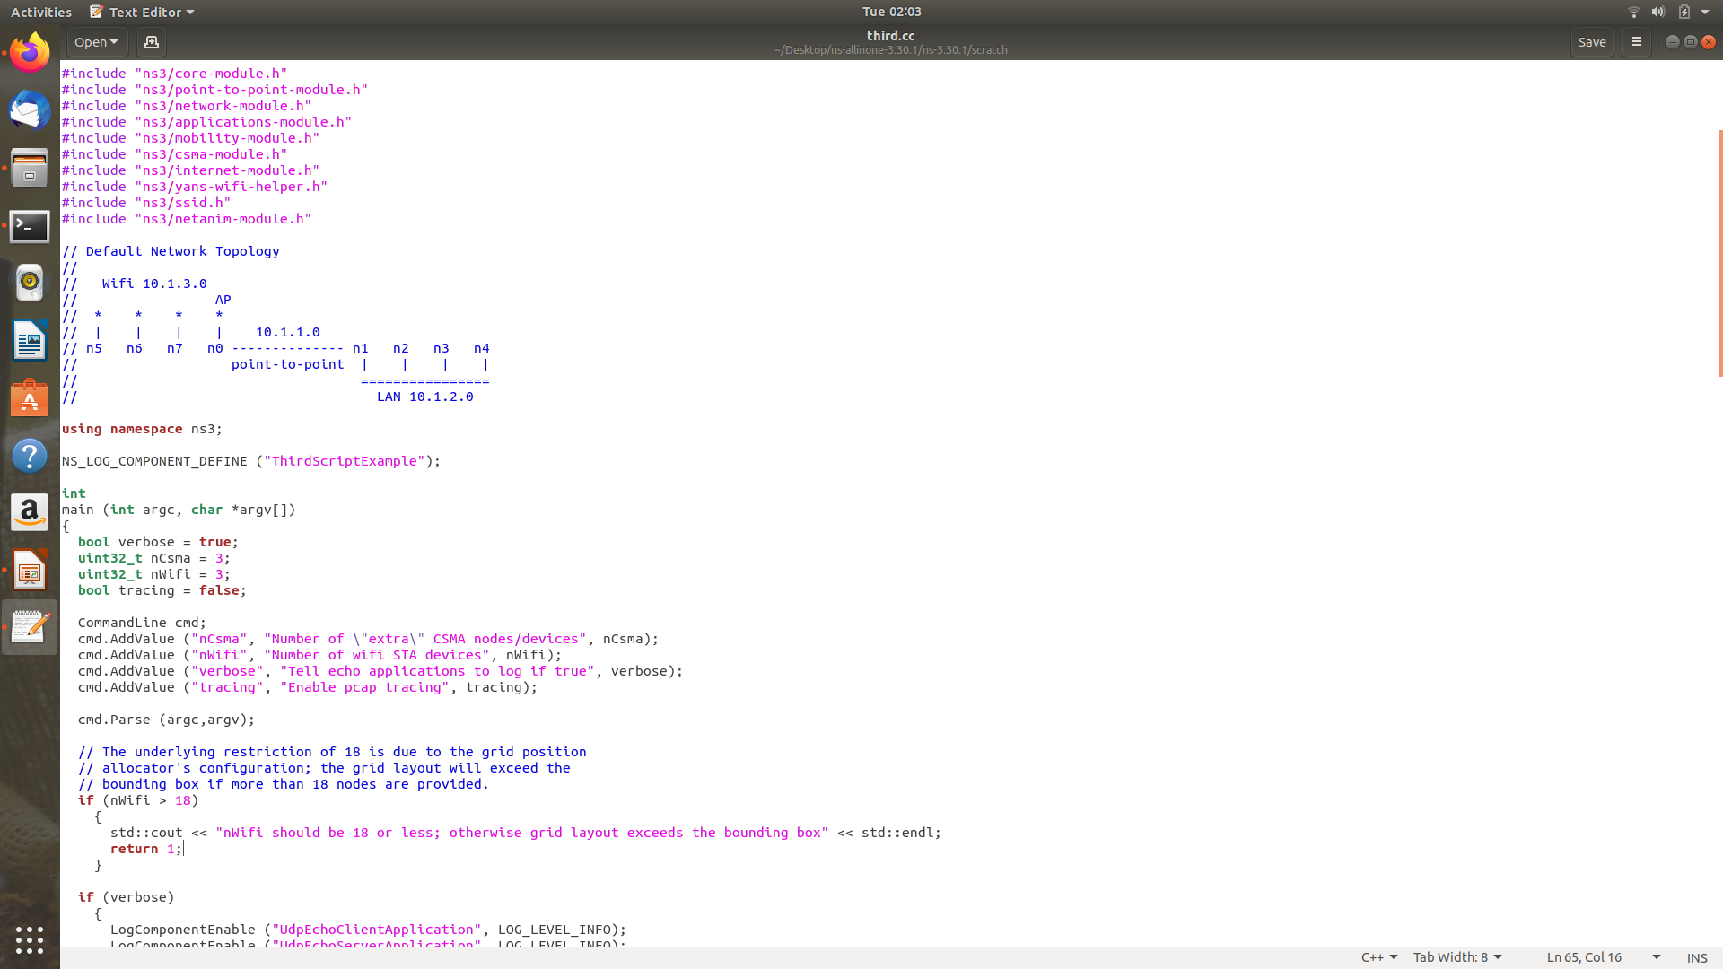
Third.cc

Slide 21
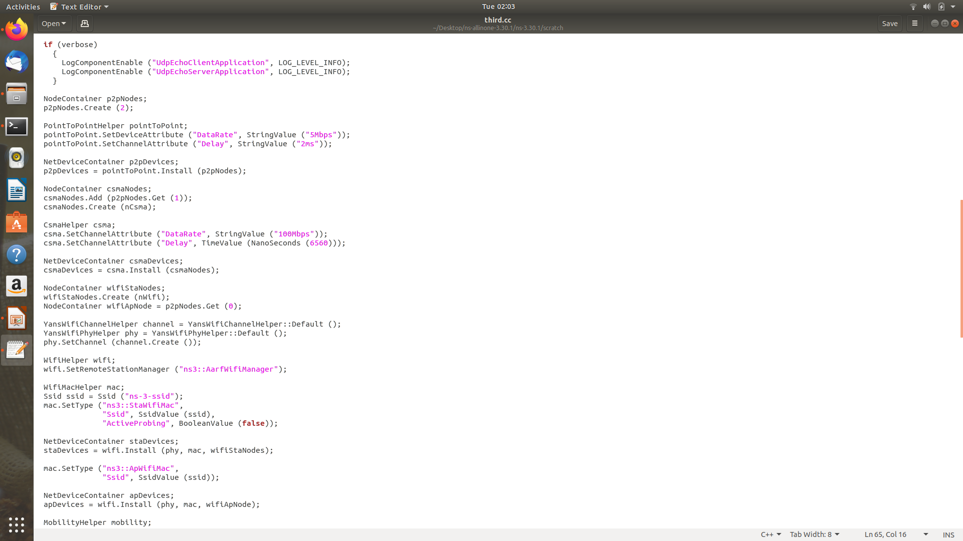
Third.cc

Slide 22
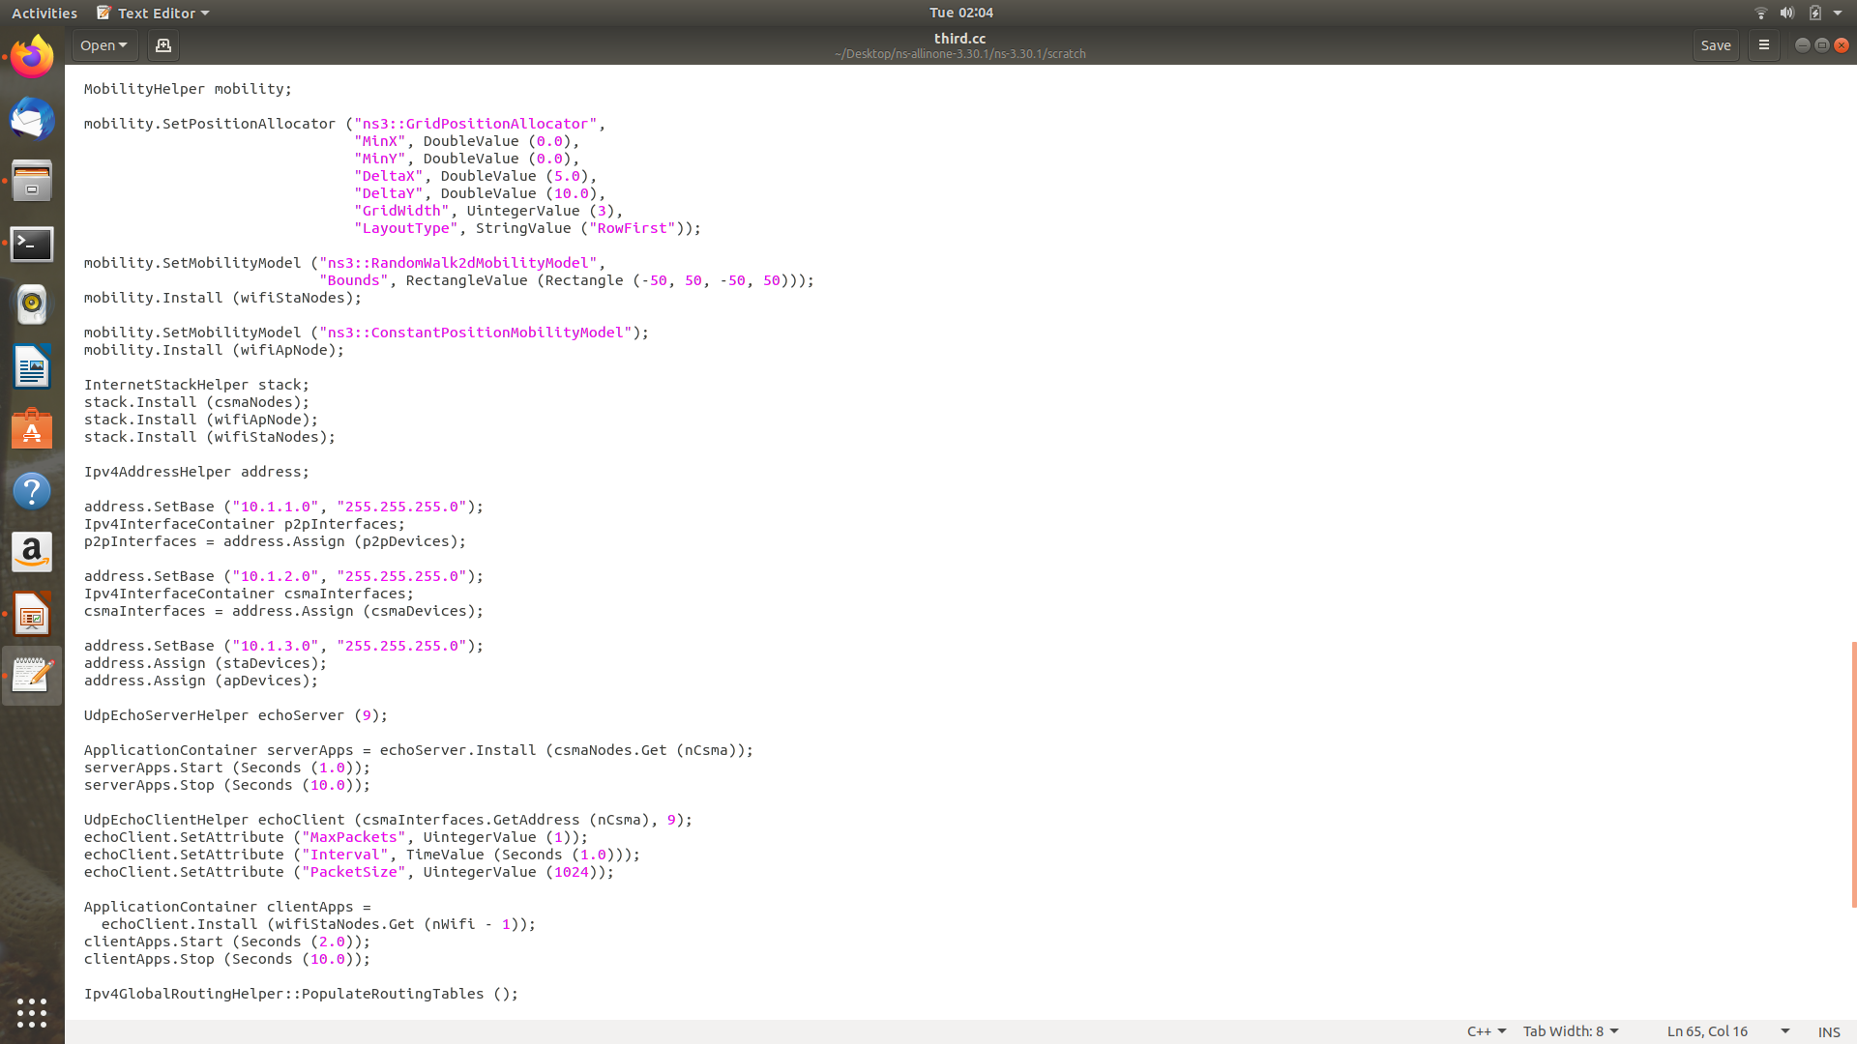
Third.cc

Slide 23
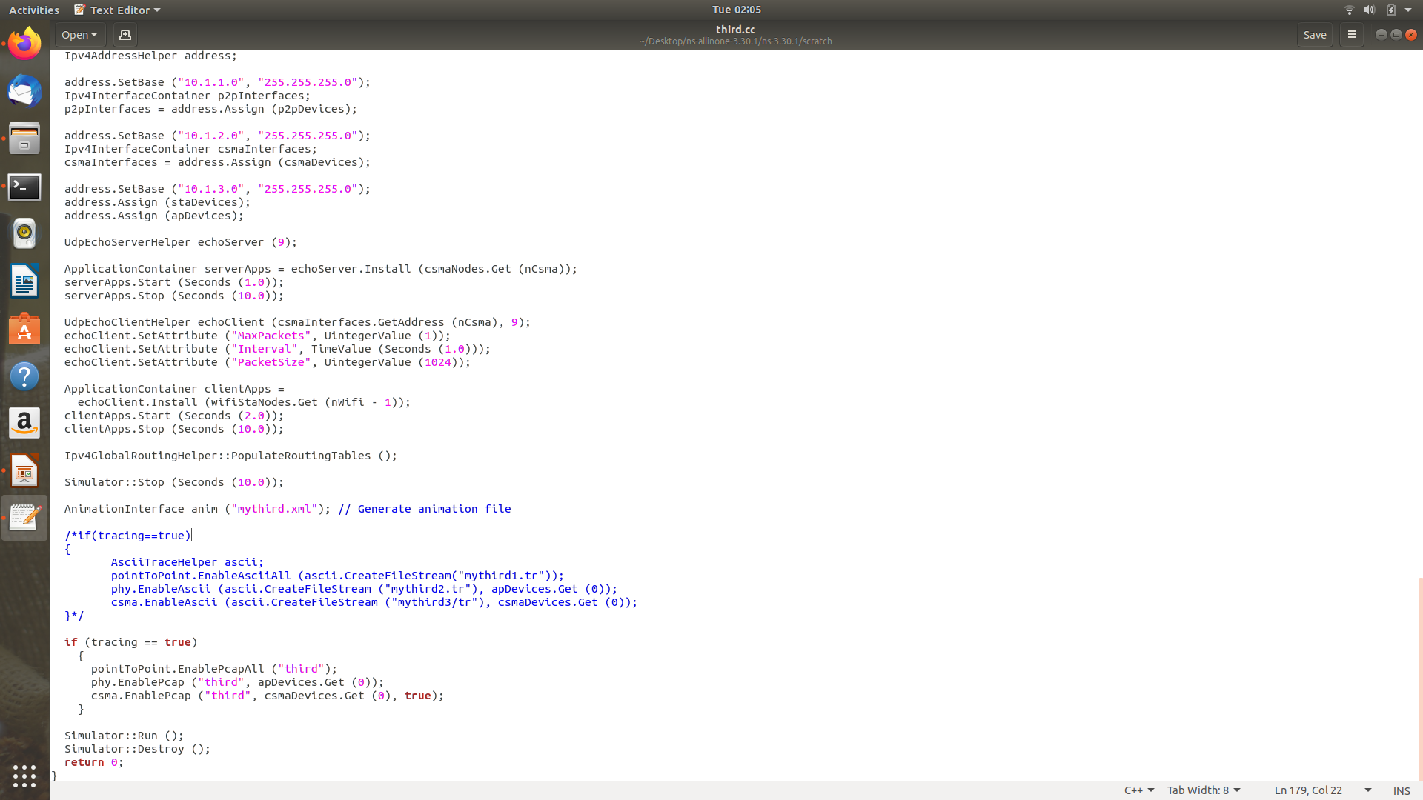
Third.cc

Slide 24
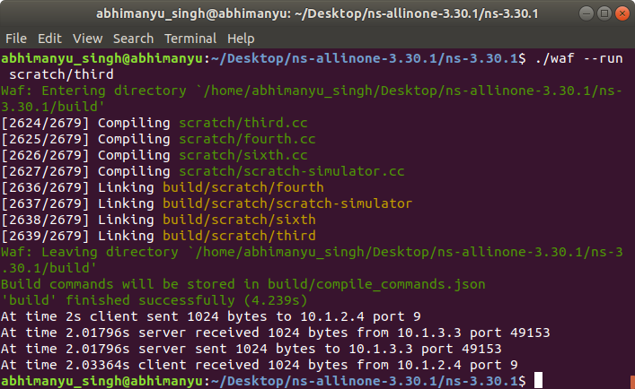
OUTPUT of third.cc

Slide 25
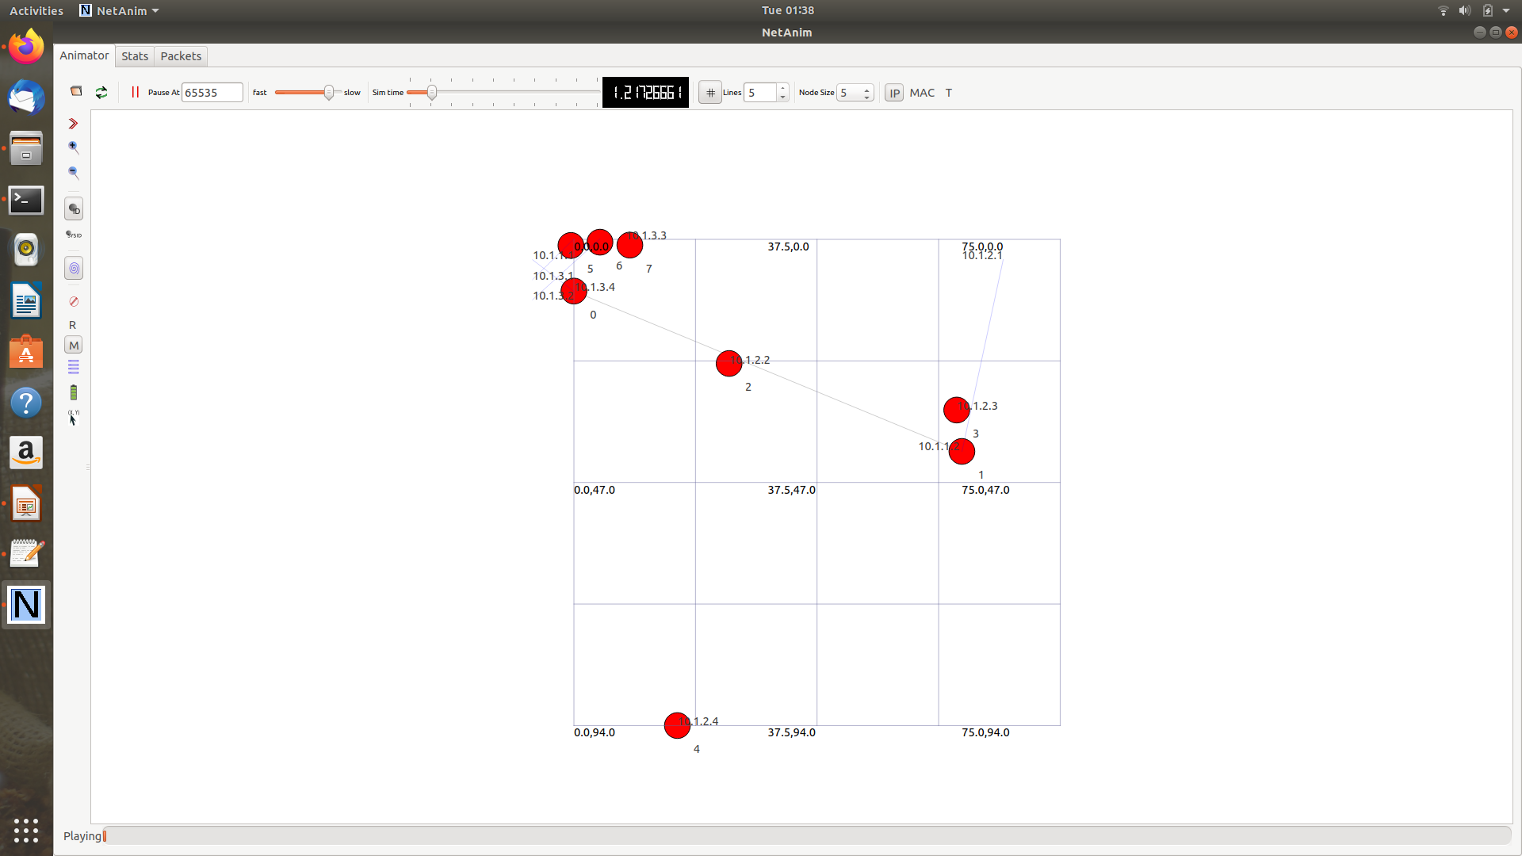
NetAnim third.cc

Slide 26
Nourishing What We Have Learnt
Refer to you tube video --> Ns-3 Basics: Course Change in third.cc
Documentation
Ideas for projects( INTERNET SURFING)

Slide 27
Since we’ve completed this, now the FUN begins ☺
First.cc
Second.cc
Third.cc

Slide 28
Don’t follow me religiously Break your head to code down
10.1.3.0
255.255.255.0
(SUBNET 3)
Node 0
C
S
M
A
Router 3
Node 1
HOST
Router 1
Router 2
Router 4
Node 2
Node 3
10.1.1.0
255.255.255.0
(SUBNET 1)
10.1.4.0
255.255.255.0
(SUBNET 4)
10.1.2.0
255.255.255.0
(SUBNET 2)
10.1.5.0
255.255.255.0
(SUBNET 5)

Slide 29
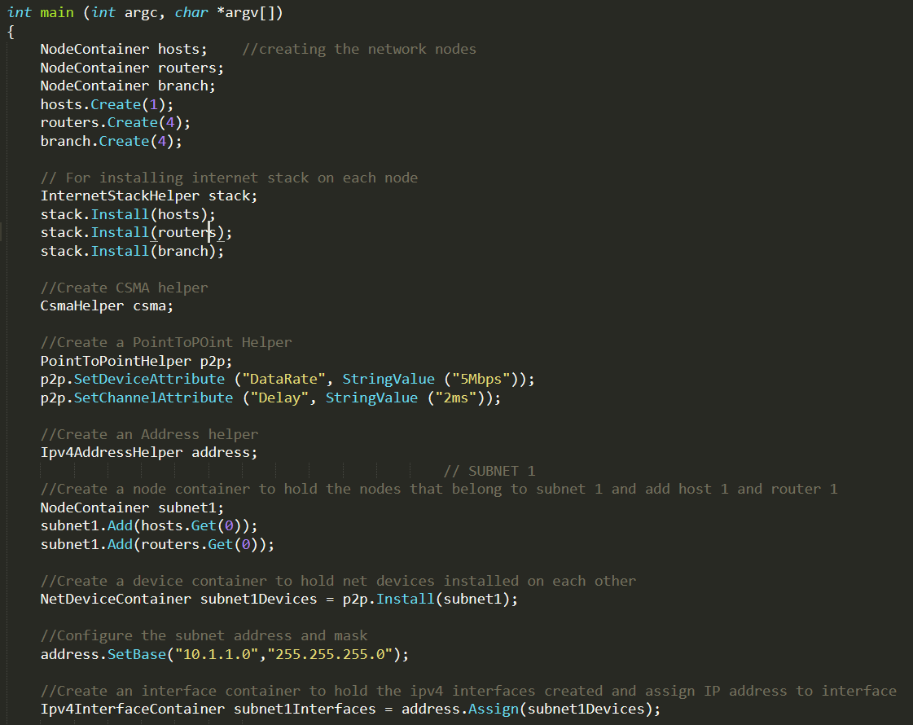
Subnet 1

Slide 30
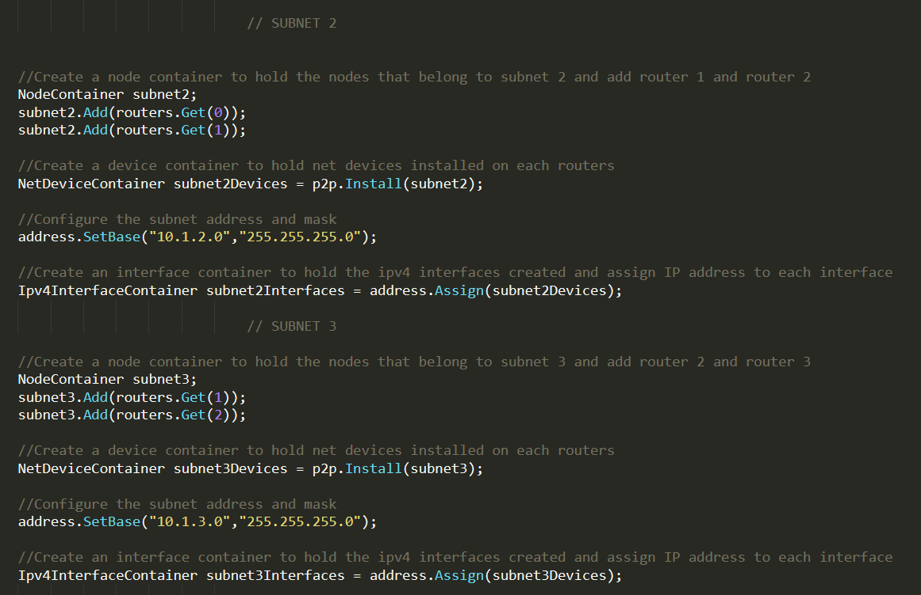
Subnet 2 and subnet 3

Slide 31
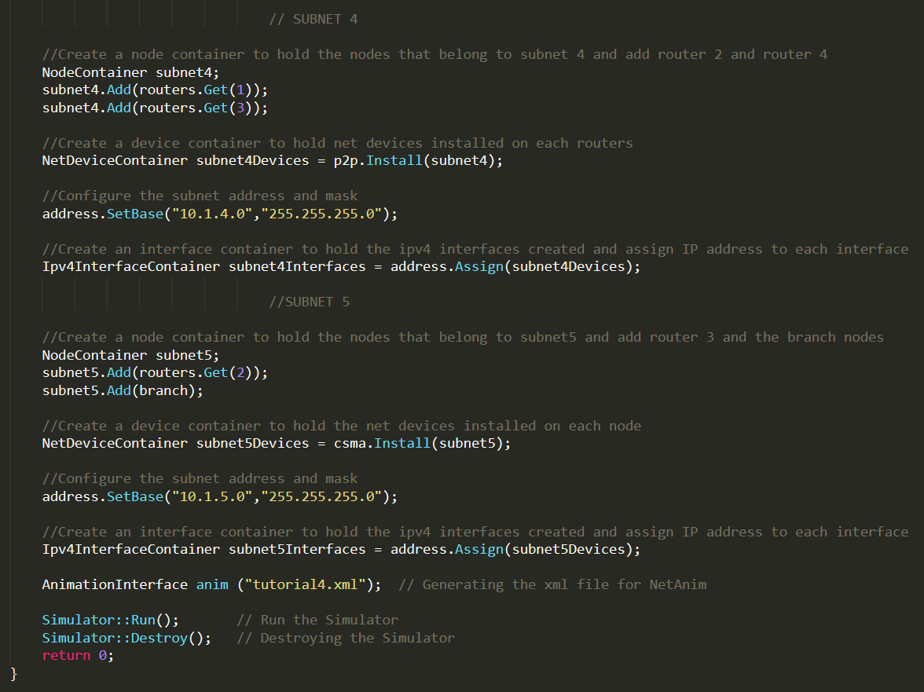
Subnet 4 and subnet 5

